Slide 1
Intro To Competitive Programming
Greg LaKomski
2/3/2024

Slide 2
Today
Brief Intro
Differences between leet code and ICPC competitive coding
Accessing and using on line judging sites
Code a couple of examples – you can follow along coding if you like
What happens next?

Slide 3
About me!
Greg LaKomski
Adjunct Lecturer
BSME, MBA, MSCS
Teach data Structures/Algorithms, Computer Architecture, Advanced Algorithms
Research on fraud detection, error detection, context sensitive clustering
Coach and teach competitive coding
General Nice guy

Slide 4
Why competitive Coding
When you study and practice and compete you will become a master of syntax – because there ain’t no googling here Toto.
You also become a master of algorithms
Algorithms are really not code at all, but ideas and thoughts and logic and math and insight and brilliance and standing on others shoulders to see further.
I can teach your momma to code syntax but I likely cannot teach your momma to understand and love algorithmic thinking.
BTW – there are exceptions and if your momma wants to study algorithms let me know!

Slide 5
That’s why employers select competitive coders
You can already code really well
you have a huge bag of tricks already
Your mind is attuned to high level, rapid learning
You have demonstrated a passion for the art as well as the science
You likely have a huge amount of flexibility and can think out of the box
You have proven you have tenacity and drive
I can go on

Slide 6
What does competitive coding look like
ICPC is a team sport – teams of three – one computer –
Contests involve solving several ~~ 8 problems over several hours
Get penalized for how long it takes to solve and the number of tries you took
Problems will vary in complexity and content – SUBSTANCIALLY
Easy to mind blowing
Regional contests -> National Contest -> World Championships
Best Texas State Regional finish – 33/71 - “Code Monsters” - 2018
Zach Stence
Chance Stovall – now at HEB
Mauricio Cerda

Slide 7
What do you need to know?
Algorithms
Data structures
Problem Solving Paradims
Coding skills
more

Slide 8
Goal for today
How competitive coding works and feels
If you want to learn more then we will see

Slide 9
Leetcode vrs ICPC
The problems feel different
Leetcode gives you a function to code, there is do data input
ICPC requires you read and understand a word problem, input the required data, do the algorithms, and then output an answer
I personally think ICPC problems make you think more deeply and are better practice for real coding work.

Slide 10
The concept of a judging site
Judging sites give you the problems
Give you a place to paste in your code and submit it
Gives you feedback on whether your code ran all of the test cases or not
You do not get to see the test cases!!

Slide 11
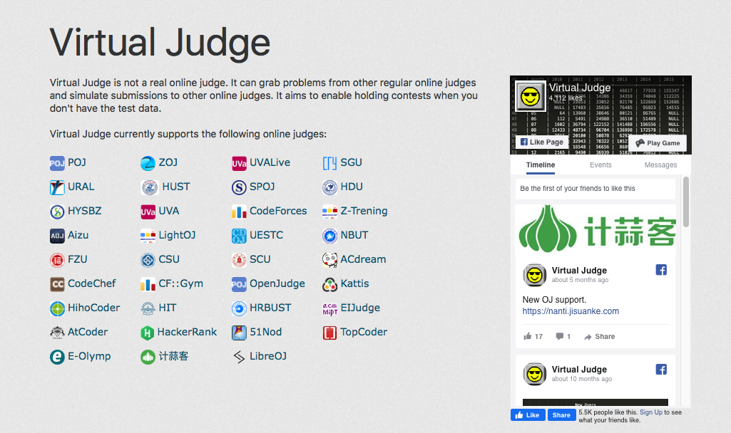
Virtual Judge compiles all of the popular sites - take your pick

Slide 12
Sites
The original was UVA
A good one is Kattis
I use both of them

Slide 13
SO if there are no questions at this point
Lets code!
I will share my screen so you can see where I am going and what I am doing. I will go slow and the problems are easy

Slide 14
What did we learn from this problem?
logging into a virtual judge
reading a comp problem and understanding inputs
using freopen to be able to use test file
using std::cin>> or std::scanf to read in an integer
usig std::getline to read in a line from file
using regex and sregex_token_iterators to parse to words
push_back into vector
using is_upper to check of capital letter
how to submit and understand output

Slide 15
Saving your problems
Part of your github repo practice should be your solved and unsolved ICPC problems
Clion makes a folder for this problem
You should create a readme in the folder explaining your approach, any issues, pseudocode
Copy paste you code into a word file, it preserves the color coding, put that in your problem folder
Make sure all test sets are in the problem file

